Slide 1
In [1]:
#import libraries import pandas as pd import numpy as np
import matplotlib as plt
In [2]:
# data importing and reading in of Data sets df = pd.read_csv('plateau_Insurance.csv')
In [3]: df Out[3]:
age sex bmi children smoker region charges
0 21 female 16.000 1 no northeast 3167.45585
1 18 male 33.770 1 no southeast 1725.55230
2 28 male 33.000 3 no southeast 4449.46200
3 33 male 22.705 0 no northwest 21984.47061
4 32 male 28.880 0 no northwest 3866.85520
... ... ... ... ... ... ... ...
1333 50 male 30.970 3 no northwest 10600.54830
1334 52 female 46.750 5 no southeast 12592.53450
1335 54 female 47.410 0 yes southeast 63770.42801
1336 37 female 47.600 2 yes southwest 46113.51100
1337 46 female 48.070 2 no northeast 9432.92530
1338 rows × 7 columns

Slide 2
In [4]:
#assess the dataset's description df.describe()
Out[4]:
age bmi children charges
count 1338.000000 1338.000000 1338.000000 1338.000000
mean 39.207025 30.682687 1.094918 13270.422265
std 14.049960 6.145674 1.205493 12110.011237
min 18.000000 14.000000 0.000000 1121.873900
25% 27.000000 26.315000 0.000000 4740.287150
50% 39.000000 30.400000 1.000000 9382.033000
75% 51.000000 34.700000 2.000000 16639.912515
max 64.000000 53.130000 5.000000 63770.428010
In [5]:
#assess the dataset for data duplicates df.duplicated().sum()
Out[5]:
1
In [6]:
#assess the dataset for missing data df.isnull().sum()
Out[6]:
age 0
sex 0
bmi 0
children 0
smoker 0
region 0
charges 0
dtype: int64
EXPLORATORY DATA ANALYSIS
UNIVARIATE ANALYSIS
In [7]:
#importing visualization libraries import matplotlib as plt
import seaborn as sns
%matplotlib inline

Slide 3
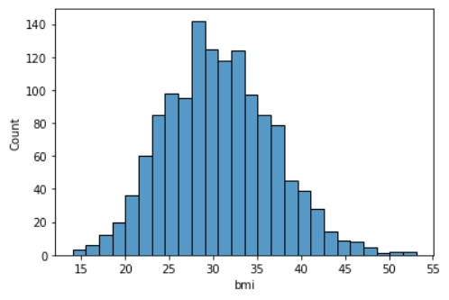
In [8]:
#univariate analysis for the body mass index feature df['bmi'].describe()
Out[8]:
count 1338.000000
mean 30.682687
std 6.145674
min 14.000000
25% 26.315000
50% 30.400000
75% 34.700000
max 53.130000
Name: bmi, dtype: float64
In [9]:
sns.histplot(df['bmi']) plt.style.use('bmh')
In [10]:
#univariate analysis for the charges feature df['charges'].describe()
Out[10]:
count 1338.000000
mean 13270.422265
std 12110.011237
min 1121.873900
25% 4740.287150
50% 9382.033000
75% 16639.912515
max 63770.428010
Name: charges, dtype: float64

Slide 4
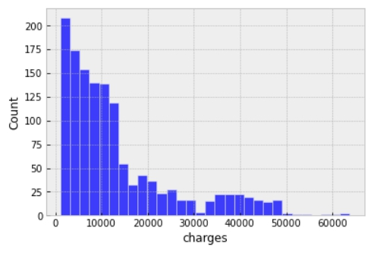
In [11]:
sns.histplot(df['charges']) plt.style.use('bmh')
In [12]:
#univariate analysis for the age feature df['age'].describe()
Out[12]:
count 1338.000000
mean 39.207025
std 14.049960
min 18.000000
25% 27.000000
50% 39.000000
75% 51.000000
max 64.000000
Name: age, dtype: float64

Slide 5
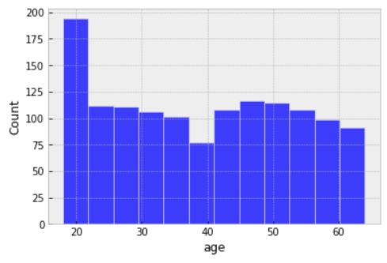
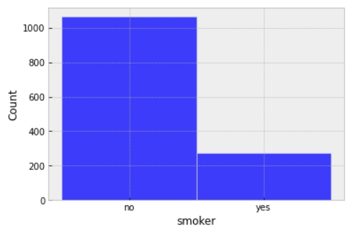
In [13]:
sns.histplot(df['age']) plt.style.use('bmh')
In [14]:
#univariate analysis for the smoker feature df['smoker'].describe()
Out[14]:
count 1338
unique 2
top no
freq 1064
Name: smoker, dtype: object
In [15]:
sns.histplot(df['smoker']) plt.style.use('bmh')
OBSERVATIONS
Highlight observations from the univariate analysis.

Slide 6
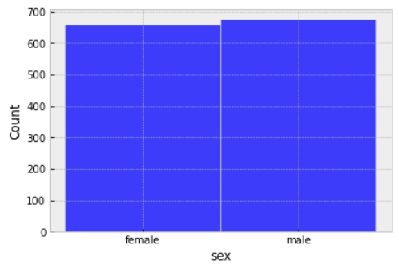
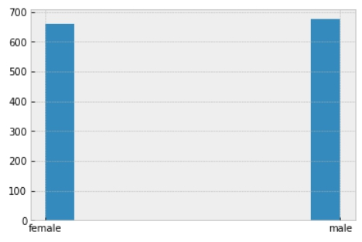
The univariate analysis is conducted for the purpose of making data easier to interpret and to understand how data is distributed within a sample of population being studied.
1. In this analysis, you can see that the number of smokers are more in the southeasthern part than the other
region stated.
In [16]:
#graphical visualiation of the sex feature sns.histplot(df['sex']) plt.style.use('bmh')
In [17]:
#OR WE CAN HAVE THIS df['sex'].hist()
Out[17]:
<AxesSubplot:>

Slide 7

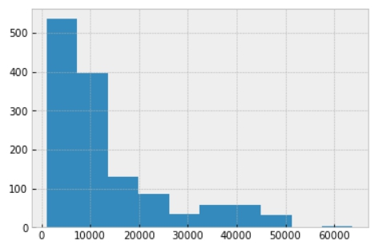
In [18]:
#graphical visualiation of the target label(charges feature) sns.histplot(df['charges'])
plt.style.use('bmh')
In [19]:
#OR WE CAN HAVE THIS df['charges'].hist()
Out[19]:
<AxesSubplot:>
In [20]:
import seaborn as sns
%matplotlib inline
import matplotlib as plt
df = pd.read_csv('plateau_Insurance.csv')

Slide 8
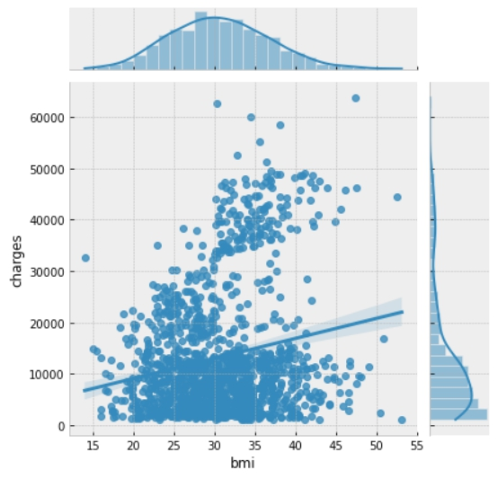
BIVARIATE ANANLYSIS
In [21]:
#jointplot exploring the relationship between the bmi vs charges features sns.jointplot(data=df,x='bmi',y='charges',kind='reg',palette='Greens')
Out[21]:
<seaborn.axisgrid.JointGrid at 0x21de2488a90>

Slide 9
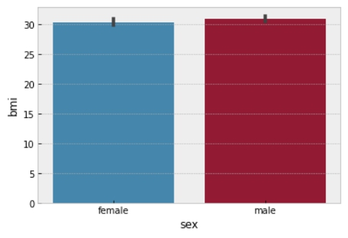
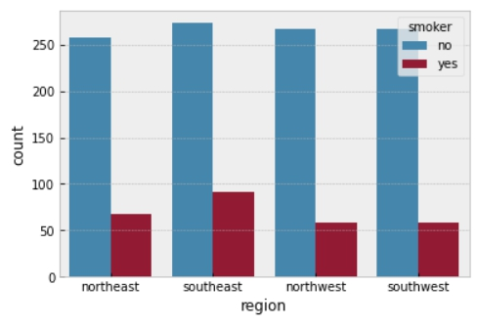
In [22]:
#exploring the distributions and the relationships between the bmi vs the sex/gender featur sns.barplot(data=df, x='sex',y='bmi')
Out[22]:
<AxesSubplot:xlabel='sex', ylabel='bmi'>
#2. Prove (or disprove) with that the BMI of females is different from that of males This satisfies the second objective proving that the bmi of female is different from men as we can see from the barplot above.
In [23]:
#bivariate analysis of the region vs smoker features sns.countplot(data=df,x='region',hue='smoker')
Out[23]:
<AxesSubplot:xlabel='region', ylabel='count'>
#3. Does the smoking habit of customers depend on their region? Yes it does, looking at the southesthern region we can see that the level of smokers is higher compare to the rest.

Slide 10
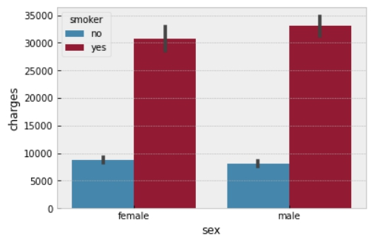
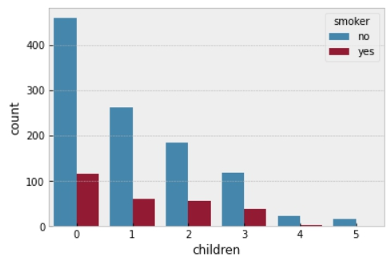
In [24]:
#exploring the relationship between the sex vs smoker vs charges features sns.barplot(data=df,x='sex',y='charges',hue='smoker')
Out[24]:
<AxesSubplot:xlabel='sex', ylabel='charges'>
#1.Prove(or disprove) that the medical claims made by the people who smoke are greater than those who don't? This satisfies the first objectives showing that the medical claim of smokers is greater than non smokers.
In [25]:
#exploring the relationship between the number of children feature and the smoker feature sns.countplot(data=df,x='children',hue='smoker')
Out[25]:
<AxesSubplot:xlabel='children', ylabel='count'>

Slide 11
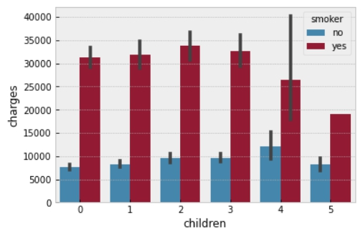
In [26]:
#bivariate analysis of the number of children feature Vs the medical claim charges feature sns.barplot(data=df,x='children', y='charges',hue='smoker')
Out[26]:
<AxesSubplot:xlabel='children', ylabel='charges'>
Observation
state down your observtaions from the bivariate analysis
The bivariate analysis is usually conducted to determine whether a statistical association exist between two variables. Now In this analysis, I observed that:
1. In the jointplot exploring the relationship between 'bmi' and 'charges', the correlation between the two data
is more concentrated at the point 35(bmi) and 1500(charges).
2. In the barplot between 'sex' and 'bmi', we can see that the bmi of female is different from men, the men bmi
is higher than females.
3. looking at the southesthern region from the countplot, we can see that the level of smokers is higher
compare to the other region.
Multivariate Analaysis

Slide 12
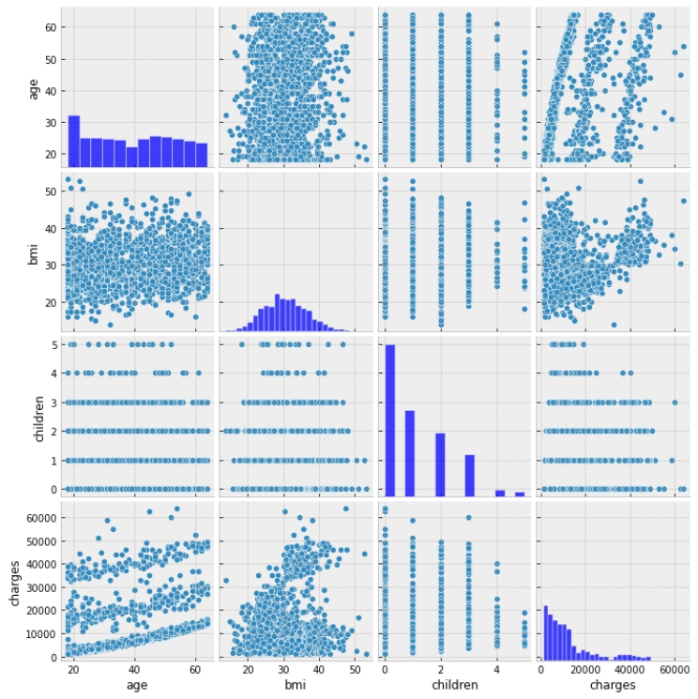
In [27]:
#use a pairplot to explore the relationship between the nummerical features in the dataset sns.pairplot(df)
Out[27]:
<seaborn.axisgrid.PairGrid at 0x21de4ef4c70>

Slide 13
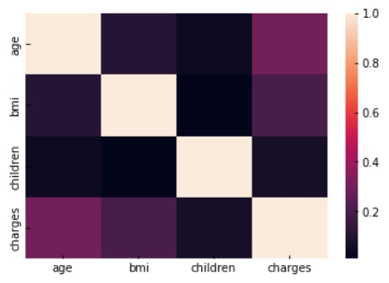
In [28]:
## heatmeap to see the correlation between features. sns.heatmap(df.corr())
Out[28]:
<AxesSubplot:>
Note: the following dataset below satisfies the fourth objectives question that asked if the mean bmi of women with no children, one child or two children are the same.
This shows that their respective mean is not the same as we can see from the zero child, one child and even two children, there is difference in the mean.

Slide 14
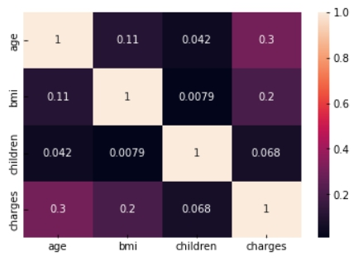
In [29]: sns.heatmap(df.corr(),annot=True) Out[29]:
<AxesSubplot:>
In [30]: df.groupby(['sex','children'])['bmi'].mean() Out[30]:
sex children
female 0
30.485502
1 30.047500
2 30.572437
3 30.436429
4 31.943182
5 30.620625
male 0 30.741719
1 31.166145
2 31.300992
3 30.922937
4 30.957500
5 28.792500
Name: bmi, dtype: float64
Observation
state down your observtaions from the multivariate analysis
The multivariate analysis is a statistical study of the data where multiple measurements are made on each experimental unit and where the relationships among multivariate measurements and their structure are important. It is also used to perform trade studies across multiple dimensions while taking into account the effects of all variables on the responses of interest. In this analysis;
1. From the heatmap, we can viusalize the strength of relationships between the numerical variables and the
variables that are related to each other.
2. You can see that the respective mean of the bmi of women with no children, one child or two children are
not the same.

Slide 15
3. Also from the pairplot, we can observe the distribution of each variable as a shown histogram along the diagonal boxes and all other boxes display a scatterplot of the relationship between each pairwise combination of variables.
In [31]:
pip install -U pandas-profiling[notebook] ..
3\lib\site-packages (from ipywidgets>=7.5.1->pandas-profiling[notebook]) (6.9.1)
Requirement already satisfied: ipython-genutils~=0.2.0 in c:\users\peter\a naconda3\lib\site-packages (from ipywidgets>=7.5.1->pandas-profiling[noteb ook]) (0.2.0)
Requirement already satisfied: widgetsnbextension~=3.5.0 in c:\users\peter \anaconda3\lib\site-packages (from ipywidgets>=7.5.1->pandas-profiling[not ebook]) (3.5.2)
Requirement already satisfied: jupyterlab-widgets>=1.0.0 in c:\users\peter \anaconda3\lib\site-packages (from ipywidgets>=7.5.1->pandas-profiling[not ebook]) (1.0.0)
Requirement already satisfied: traitlets>=4.3.1 in c:\users\peter\anaconda 3\lib\site-packages (from ipywidgets>=7.5.1->pandas-profiling[notebook]) (5.1.1)
Requirement already satisfied: ipython>=4.0.0 in c:\users\peter\anaconda3 \lib\site-packages (from ipywidgets>=7.5.1->pandas-profiling[notebook]) (8.2.0)
Requirement already satisfied: tornado<7.0,>=4.2 in c:\users\peter\anacond a3\lib\site-packages (from ipykernel>=4.5.1->ipywidgets>=7.5.1->pandas-pro
In [32]:
import seaborn as sns import pandas as pd import numpy as np
In [33]:
from pandas_profiling import ProfileReport

Slide 16
In [34]: df.profile_report()
Summarize dataset: 100%
Generate report structure: 100%
Render HTML: 100%
36/36 [00:17<00:00, 3.30it/s, Completed]
1/1 [00:06<00:00, 6.47s/it]
1/1 [00:01<00:00, 1.94s/it]

Slide 17
Overview
Dataset statistics
Number of variables
7
Number of observations 1338
Missing cells 0
Missing cells (%) 0.0%
Duplicate rows 1
Duplicate rows (%) 0.1%
Total size in memory 73.3 KiB
Average record size in memory 56.1 B
Variable types
Numeric
4
Categorical 2
Boolean 1
Alerts
Dataset has 1 (0.1%) duplicate rows
Duplicates
age is highly correlated with charges High correlation
charges is highly correlated with age and 1 other fields
(age, smoker)
High correlation
smoker is highly correlated with charges High correlation
Out[34]:
Thanks!
KARNAP BINSAK RIMVEN.

